Slide 1

Spatial Regression Models
FELIPE bUCHBINDER

Slide 2

A whole new world…

Slide 3

But let’s see the basics

Slide 4
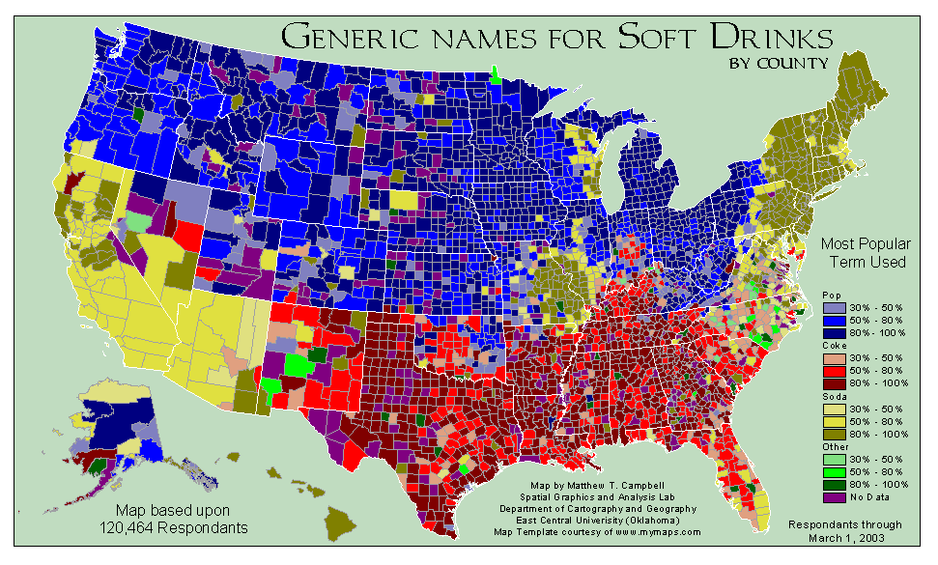
Take a look at this map on how americans name soft drinks

Slide 5
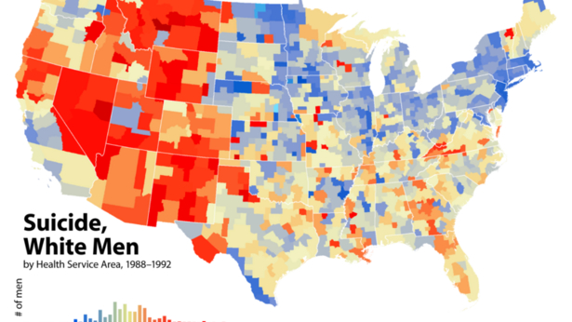
And this map on suicide rates of white men

Slide 6
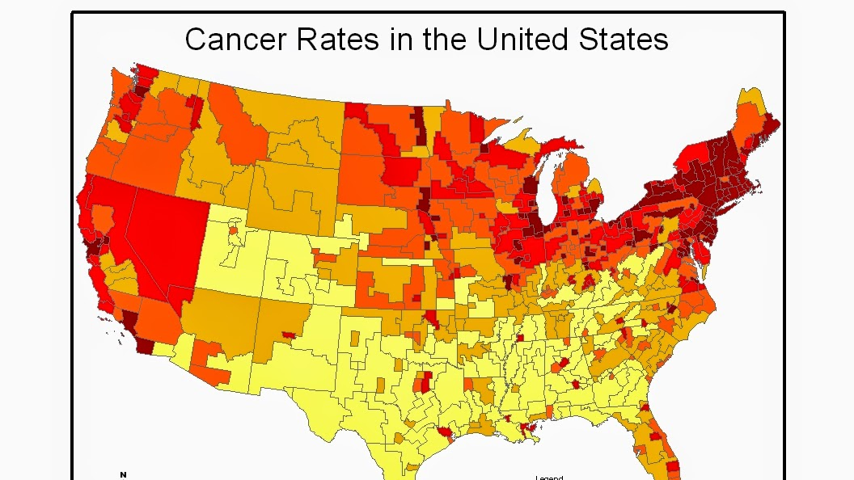
And this one on cancer rates in the US

Slide 7
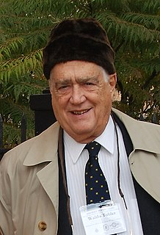
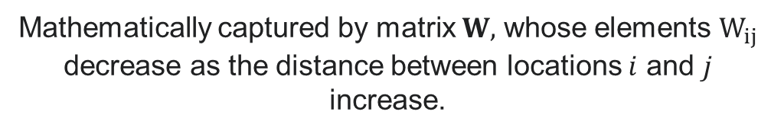
Tobler’s first law of geography
“Everything is related to everything else, but near things are more related than distant things”
Mathematically captured by matrix $W,$ whose elements $W_{ij}$ decrease as the distance between locations $i$ and $j$ increase.

Slide 8
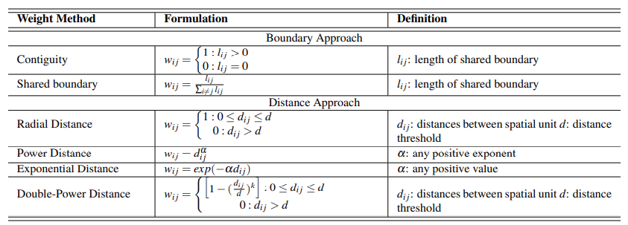

Weight matrix $W$
Ermagun & Levinson, An Introduction to the Network Weight Matrix, Presentation at 96th Annual Transportation Research Board Meeting, January 2017

Slide 9
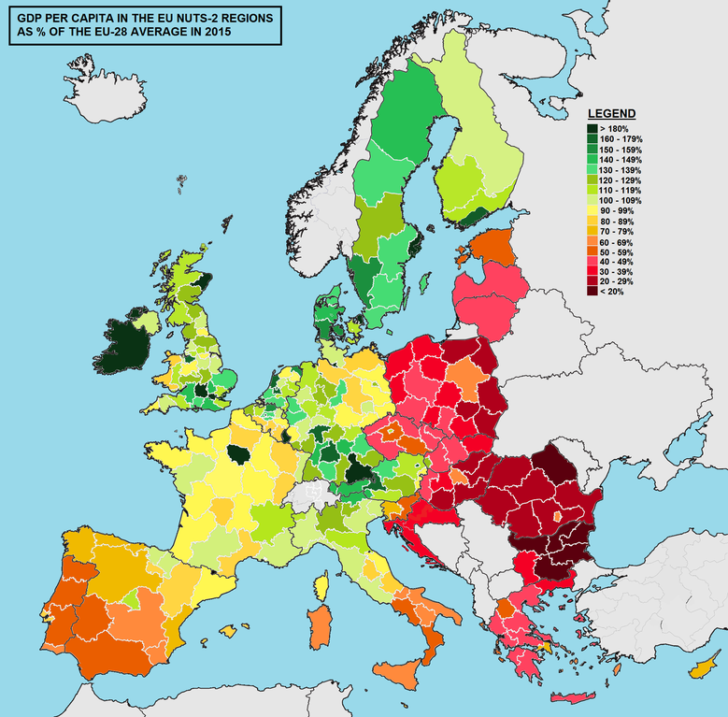

How to measure spatial autocorrelation? Moran’s I
$$ℐ=\frac{\sum_{i}{\sum_{j}{W_{ij}\left(X_{i}−\overline{X}\right)\left(X_{j}−\overline{X}\right)}}}{\sum_{i}{{\left(X_{i}−\overline{X}\right)}^{2}}}$$
Analogous to Pearson Correlation, but for spatial data and obeying Tobler’s 1st Law of Geography

Slide 10
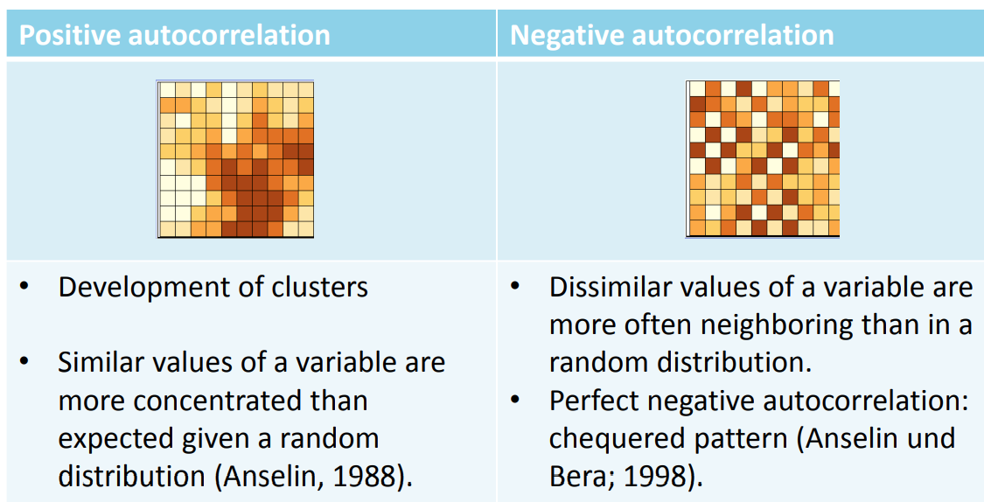

Slide 11
spatial regression models
Spatial Lag Regression
Spatial Error Regression
Spatial Durbin Regression

Slide 12
spatial regression models
Spatial Lag Regression
Spatial Error Regression
Spatial Durbin Regression

Slide 13
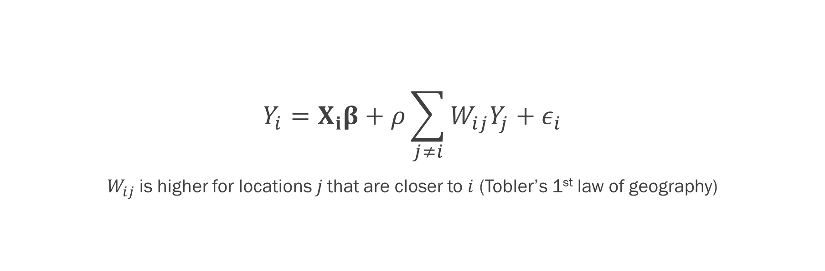
Spatial lag regression
$$Y_{i}=X_{i}β+ρ\sum_{j≠i}{W_{ij}Y_{j}}+ε_{i}$$
$W_{ij}$is higher for locations$j$ that are closer to $i$ (Tobler’s 1st law of geography)

Slide 14
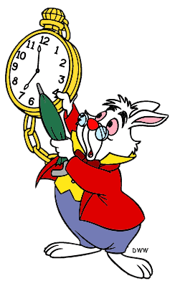


How could we add to this model…
… a random effect?
… a dynamic component?
… a fixed effect?

Slide 15
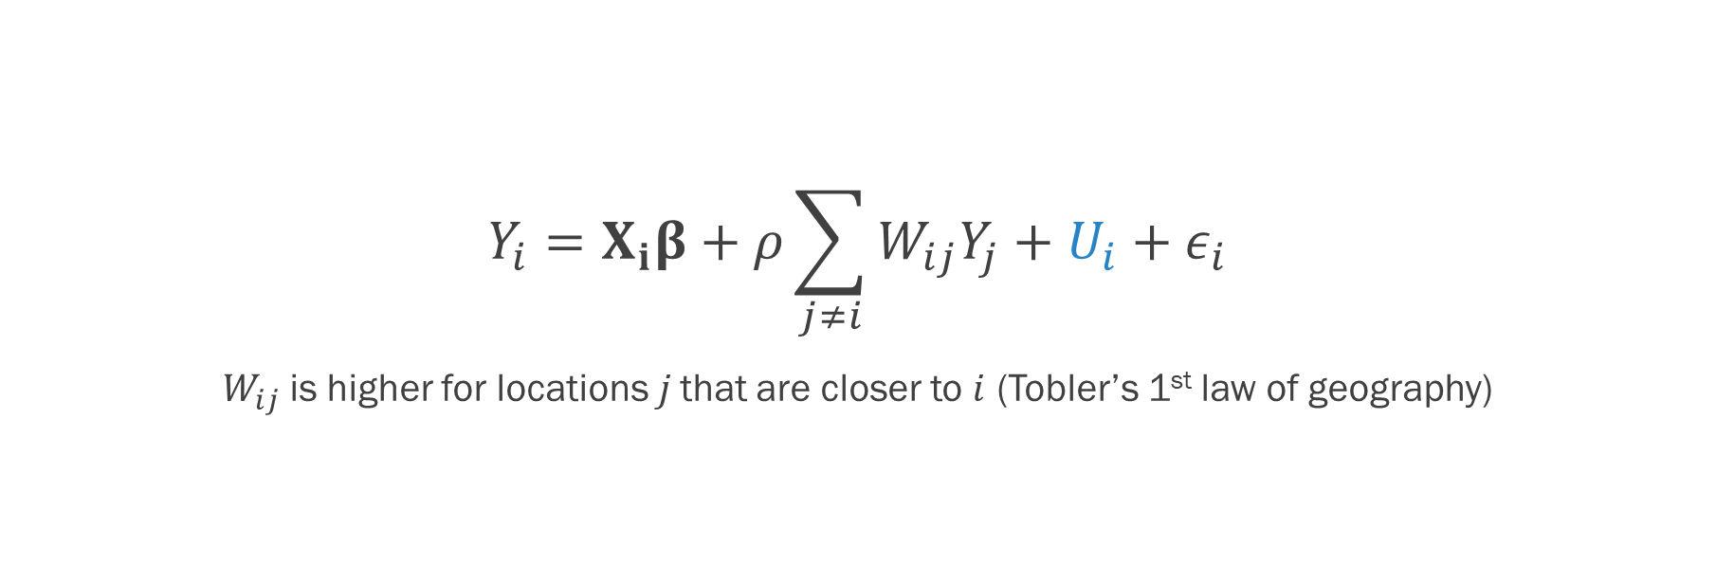
Spatial lag regression with spatial fixed-effects
$$Y_{i}=X_{i}β+ρ\sum_{j≠i}{W_{ij}Y_{j}}+U_{i}+ε_{i}$$
$W_{ij}$is higher for locations$j$ that are closer to $i$ (Tobler’s 1st law of geography)

Slide 16
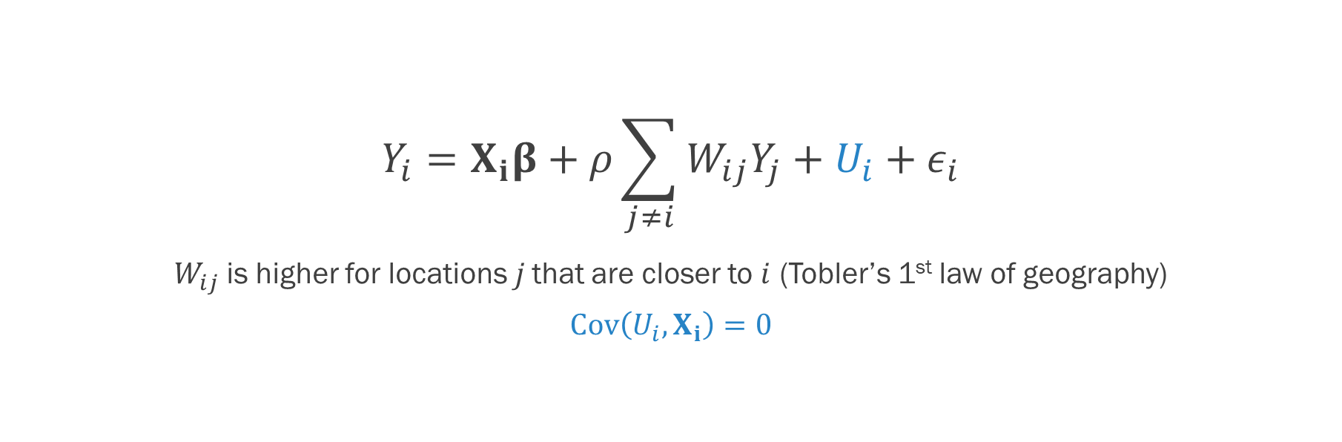
Spatial lag regression with spatial random-effects
$$Y_{i}=X_{i}β+ρ\sum_{j≠i}{W_{ij}Y_{j}}+U_{i}+ε_{i}$$
$W_{ij}$is higher for locations$j$ that are closer to $i$ (Tobler’s 1st law of geography)
$$Cov\left(U_{i},X_{i}\right)=0$$

Slide 17

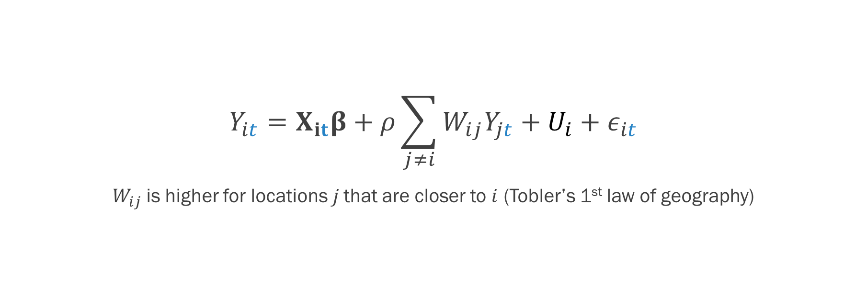
Dynamic Spatial lag regression
$$Y_{it}=X_{it}β+ρ\sum_{j≠i}{W_{ij}Y_{jt}}+U_{i}+ε_{it}$$
$W_{ij}$is higher for locations$j$ that are closer to $i$ (Tobler’s 1st law of geography)
$$Fixed Effects: Cov\left(U_{i},X_{i}\right)≠0$$
$$Random Effects: Cov\left(U_{i},X_{i}\right)=0$$

Slide 18
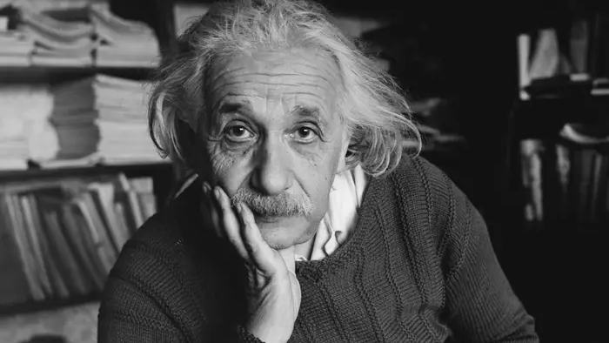
Which time series model is analogous to a spatial lag model?

Slide 19
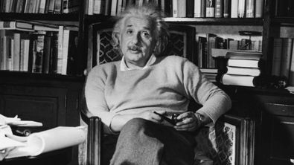
An autoregressive model!

Slide 20
spatial regression models
Spatial Lag Regression
Spatial Error Regression
Spatial Durbin Regression

Slide 21
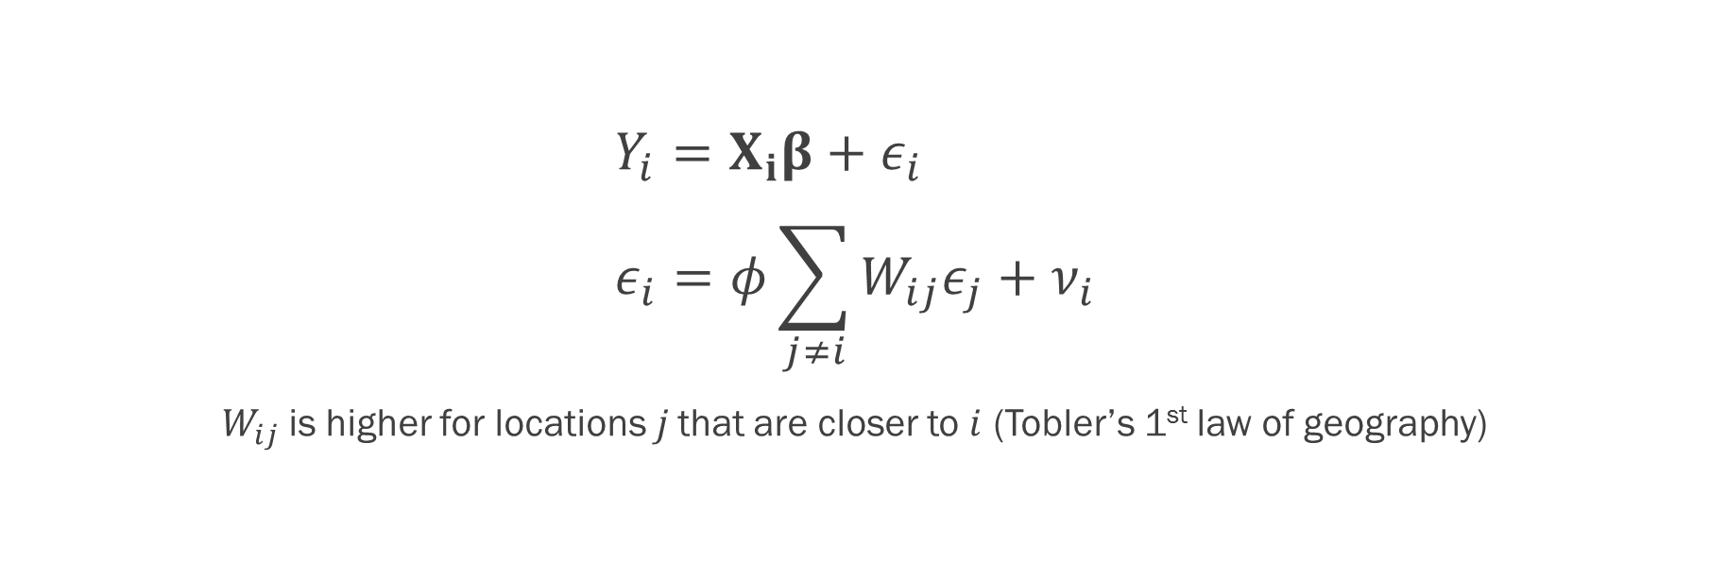
Spatial error regression
$$Y_{i}=X_{i}β+ε_{i} \\ ε_{i}=φ\sum_{j≠i}{W_{ij}ε_{j}}+ν_{i}$$
$W_{ij}$is higher for locations$j$ that are closer to $i$ (Tobler’s 1st law of geography)

Slide 22
How could we add to this model…
… a random effect?
… a dynamic component?
… a fixed effect?

Slide 23

I love class discussions!

Slide 24
Which time series model is analogous to a spatial error model?

Slide 25
A MOVING AVERAGE model!

Slide 26
spatial regression models
Spatial Lag Regression
Spatial Error Regression
Spatial Durbin Regression

Slide 27
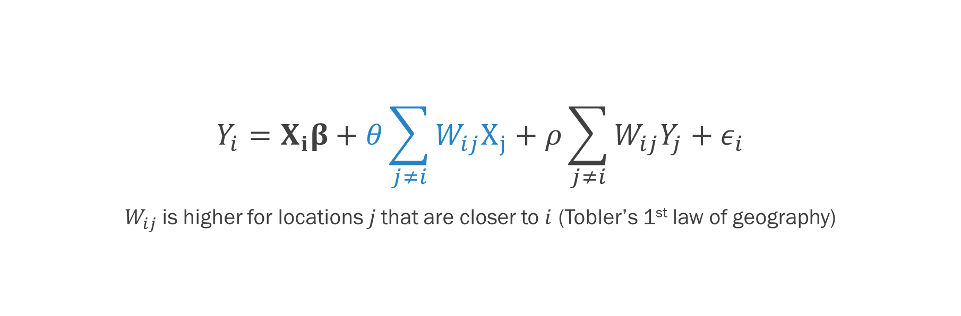
Spatial durbin Model
$$Y_{i}=X_{i}β+θ\sum_{j≠i}{W_{ij}X_{j}}+ρ\sum_{j≠i}{W_{ij}Y_{j}}+ε_{i}$$
$W_{ij}$is higher for locations$j$ that are closer to $i$ (Tobler’s 1st law of geography)

Slide 28
How could we add to this model…
… a random effect?
… a dynamic component?
… a fixed effect?

Slide 29
I love class discussions!

